Slide 1
Digital Portfolio
STUDENT NAME: Sanjay Stefin S
REGISTER NO AND NMID: 2422J0363 | asbruag2422j0363
DEPARTMENT: BCA (Bachelor of Computer Applications)
COLLEGE: Sri Krishna Adithya College of Arts & Science
UNIVERSITY: BARATHIYAR UNIVERSITY

Slide 2
PROJECT TITLE
INTERACTIVE DIGITAL PORTFOLIO USING FRONT END DEVELOPMENT

Slide 3


AGENDA
Problem Statement
Project Overview
End Users
Tools and Technologies
Portfolio design and Layout
Features and Functionality
Results and Screenshots
Conclusion
Github Link
3/21/2024 Annual Review

Slide 4

PROBLEM STATEMENT
In today’s digital era, traditional resumes alone are not enough to showcase skills and projects effectively. Many students and professionals lack a structured online presence to highlight their work. A digital portfolio provides an interactive and accessible platform to present achievements, Skills and experiences

Slide 5

PROJECT OVERVIEW
Brief summary of your project.
What your portfolio contains (About me, Projects, Skills, Contact).
Main idea: Showcase personal achievements, skills and projects.

Slide 6

WHO ARE THE END USERS?
Students (Academic Projects, Resumes).
Job seekers (to share with recruiters).
Freelancers (to show clients).
Professionals (to highlight experience and achievements)

Slide 7

TOOLS AND TECHNIQUES
HTML → Structure (pages, sections).
CSS → Styling (colors, layouts, responsiveness).
JavaScript → Interactivity (Navigation menu, animations, form validation).
Edited code using VS code and hosted in GitHub pages

Slide 8
POTFOLIO DESIGN AND LAYOUT
Sections included:
Home / About me
Projects
Skills
Internship
Achievements
Contact
8

Slide 9
FEATURES AND FUNCTIONALITY
Navigation bar with smooth scrolling.
Project showcase with images / details.
Interactive elements (hover effects, animations).
Contact form (with validation).
Responsive Design for all devices.

Slide 10
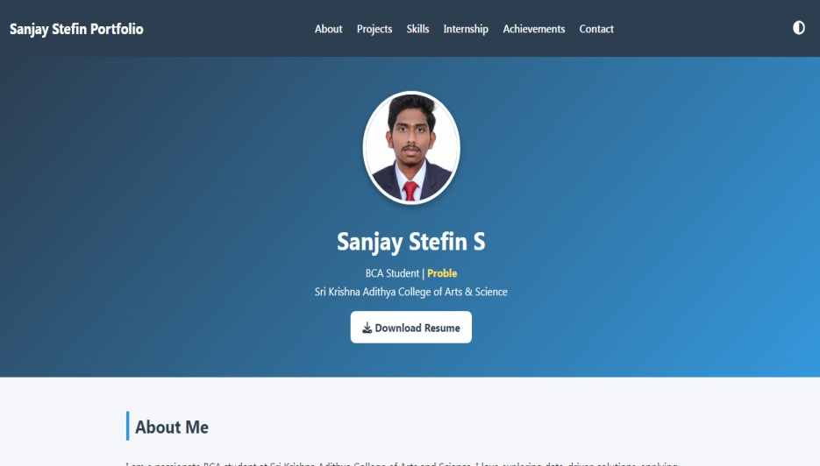
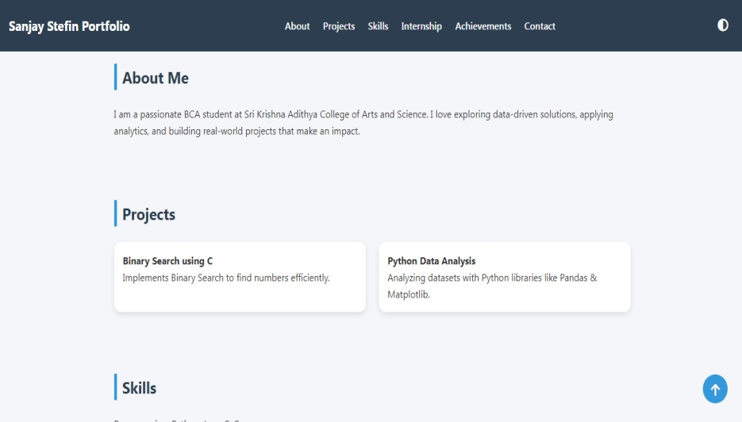

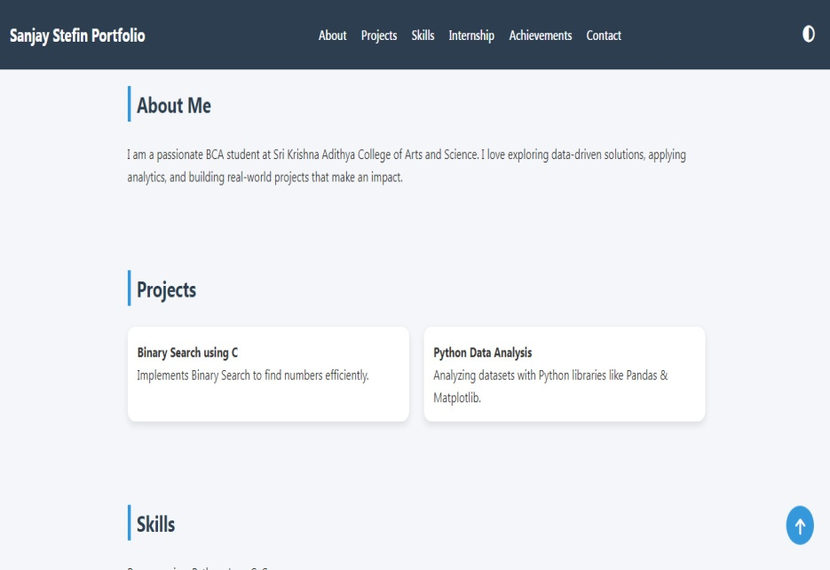
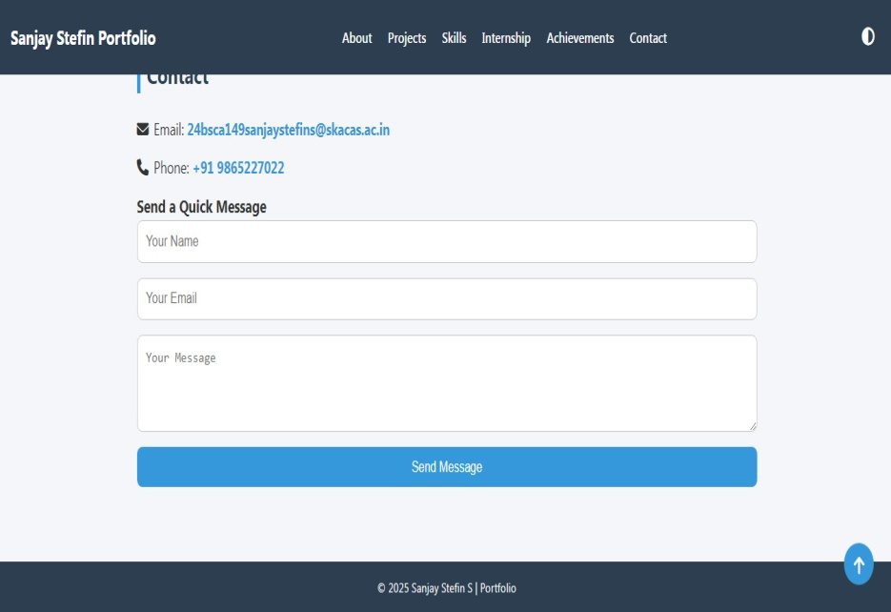
RESULTS AND SCREENSHOTS
3/21/2024 Annual Review
10

Slide 11
CONCLUSION
A responsive personal portfolio showcasing projects, skills, internships and achievements. It serves as a digital resume and personal branding tool, built with modern front-end technologies.
11

Slide 12
GitHub Link
My GitHub Link:
https://github.com/24bsca149sanjaystefins-maker/SanjayStefin-NMProject.git
12

